Slide 1
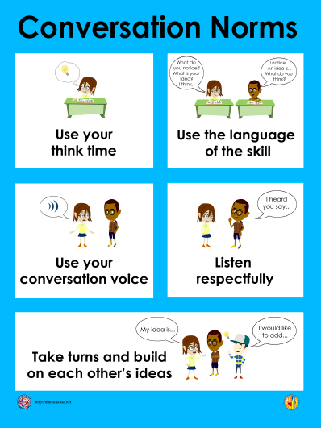
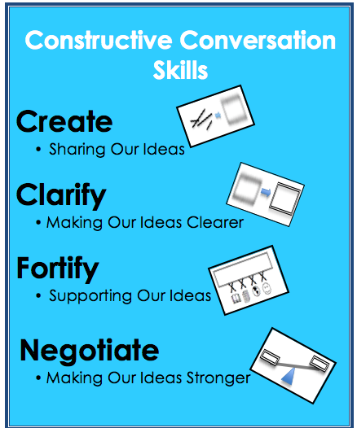
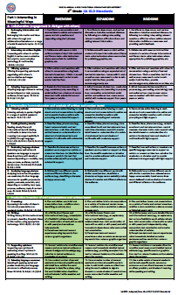
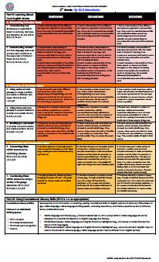
Local District West K-12 EL Designee Meeting August, 2016 Ideas to Support Language Skill Development Throughout the Day and Throughout the Year (Powerpoint includes ideas collected from the Elementary EL Cadre. These powerpoint slides are hidden.)

Slide 2
Listening Domain (Just K-1st and 6th-12th)

Slide 10
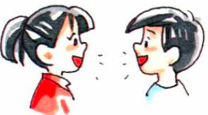
Speaking Domain (Just K-1st)

Slide 15
Reading Domain Word Analysis

Slide 20
Reading Domain Fluency and Vocabulary

Slide 25
Reading Domain Reading Comprehension

Slide 30
Writing Domain Grammar and Structure

Slide 35
Writing Domain Sentences

Slide 40
Writing Domain Short Composition

